Slide 1
Digital Image Processing
Lecture # 3A
Image Transformations and Spatial Filtering
Imran Siddiqi
imran.siddiqi@mcs.edu.pk
Computer Science Department
College of Telecommunication Engineering
National University of Sciences and Technology
Notes:
Good Morning! My name is Chao.
Today I like to give a topic on “Content-Based Retrieval” which so called “CBR” in multimedia systems.

Slide 2
Contents
Image Enhancement
Types of Enhancement Operations
Point Processing
  Linear, Logarithmic & Power Law Transformations
  Contrast Stretching
  Gray Level Slicing
  Bit-Plane Slicing

Slide 3
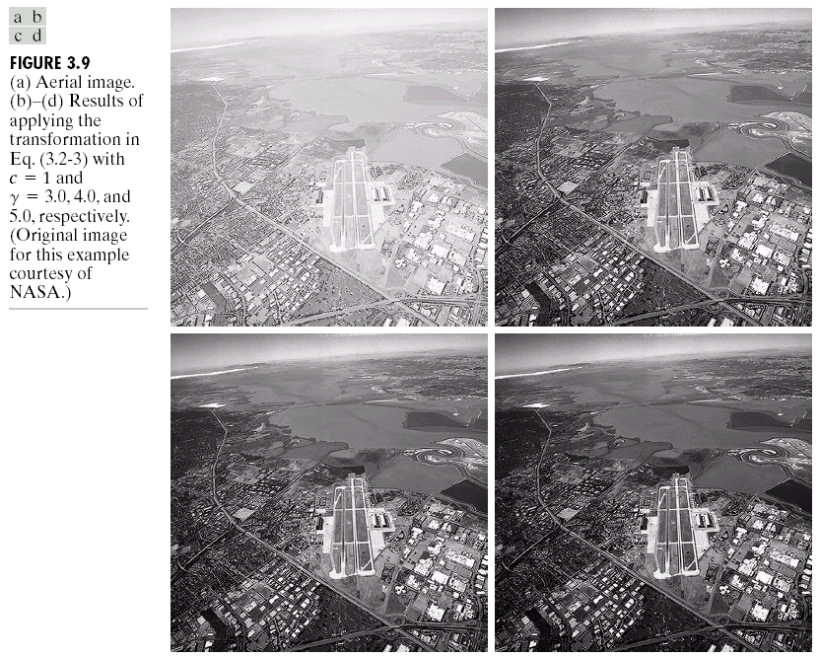
Image Enhancement

Slide 4

Image Enhancement

Slide 5

Image Enhancement
Process an image so that the result is more suitable than the original image for a specific application
Image Enhancement Methods
  Spatial Domain: Direct manipulation of pixels in an image
  Frequency Domain: Process the image by modifying the Fourier transform of an image
This Chapter – Spatial Domain

Slide 6
Types of image enhancement operations
Point/Pixel operations
Output value at specific coordinates (x,y) is dependent only on the input value at (x,y)
Local operations
The output value at (x,y) is dependent on the input values in the neighborhood of (x,y)
Global operations
The output value at (x,y) is dependent on all the values in the input image

Slide 7
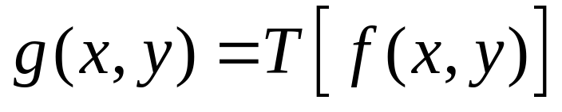
Basic Concepts
Most spatial domain enhancement operations can be generalized as:
f (x, y) = the input image
g (x, y) = the processed/output image
T = some operator defined over some neighbourhood of (x, y)

Slide 8
Basic Concepts
A square or rectangular sub-image area centered at (x,y)
Origin
x
(x, y)
y
Image f (x, y)

Slide 9
Point Processing
In a digital image, point = pixel
Point processing transforms a pixel’s value as function of its value alone;
It does not depend on the values of the pixel’s neighbors.

Slide 10
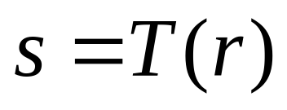
Point Processing
Neighborhood of size 1x1:
g depends only on f at (x,y)
T: Gray-level/intensity transformation/ mapping function
  r = gray level of f at (x,y)
  s = gray level of g at (x,y)

Slide 11
Point Processing using Look-up Tables
A look-up table (LUT) implements a functional mapping.
255
E.g.:
index
value
...
101
102
103
104
105
106
...
...
64
68
69
70
70
71
...
127
output value
0
0
127
255
input value
input
output

Slide 12
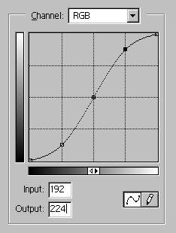
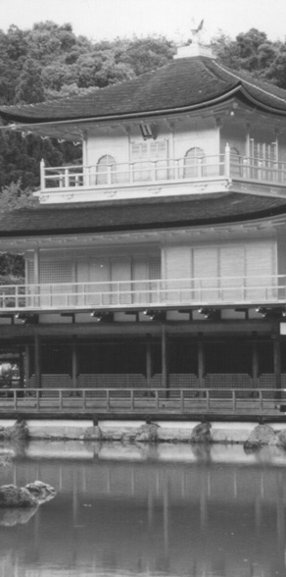
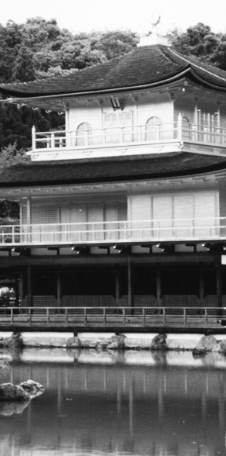
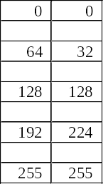
Point Processing using Look-up Tables
input
output
.
.
.
.
.
.
.
.
a pixel with this value
.
.
is mapped to this value
.
.
cell index
contents
.
.
.
.
.
.
.
.
.
.
.
.

Slide 13
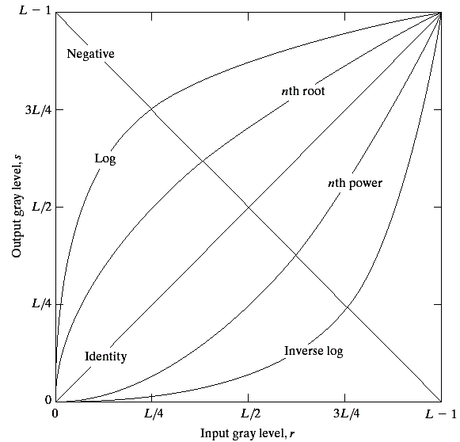
Point Processing Transformations
There are many different kinds of grey level transformations
Three of the most
common are shown
here
  Linear
    Negative/Identity
  Logarithmic
    Log/Inverse log
  Power law
    n^{th} power/n^{th} root

Slide 14
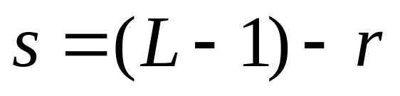
Point Processing Example:
Negative Images
Reverses the gray level order
For L gray levels, the transformation has the form:
Negative images are useful for enhancing white or grey detail embedded in dark regions of an image

Slide 15
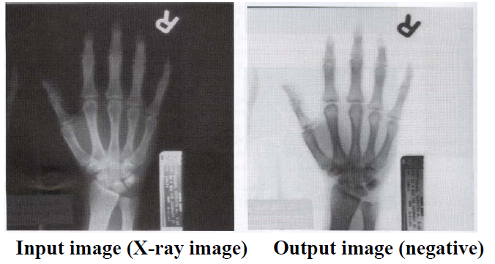
Point Processing Example:
Negative Images

Slide 16
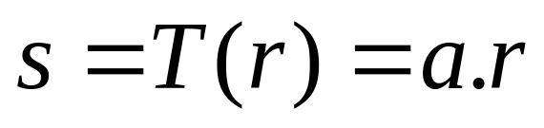
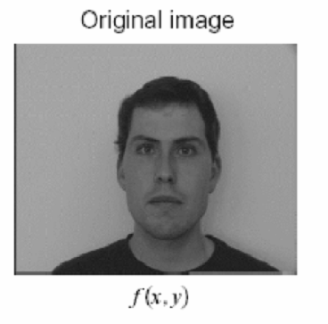
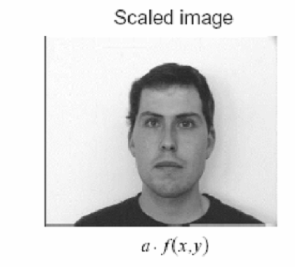
Point Processing Example:
Intensity Scaling

Slide 17
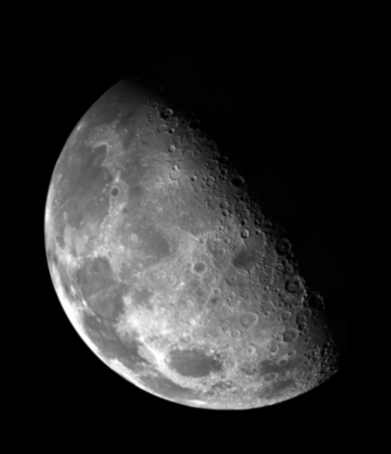

Point Processing Example:
Thresholding
Segmentation of an object of interest from a background
1.0
r > threshold
s =
0.0
r <= threshold

Slide 18
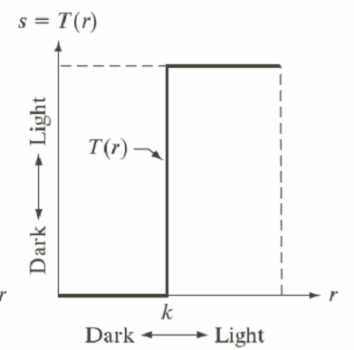
Point Processing Example:
Thresholding
1.0 r > threshold
s =
0.0 r <= threshold

Slide 19
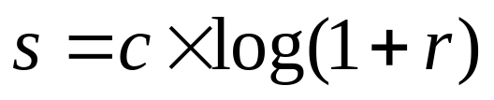
Logarithmic Transformations
The general form of the log transformation is
The log transformation maps a narrow range of low input grey level values into a wider range of output values
The inverse log transformation performs the opposite transformation

Slide 20
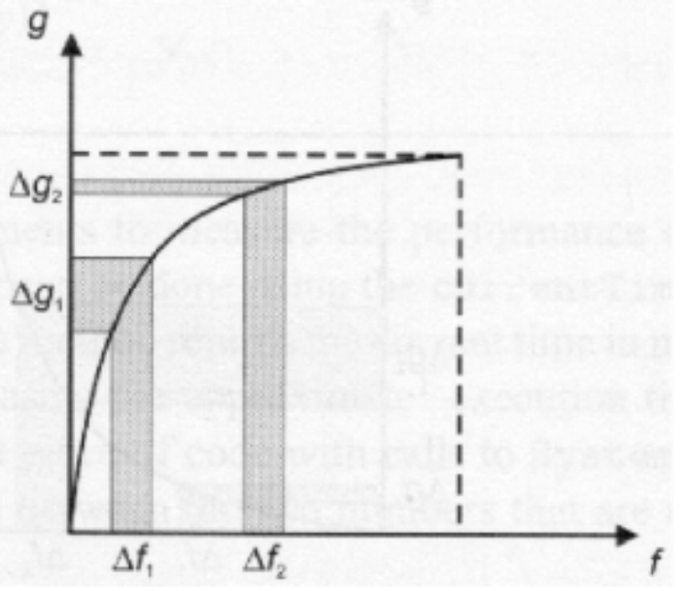
Logarithmic Transformations
Properties
  For lower amplitudes of input image the range of gray levels is expanded
  For higher amplitudes of input image the range of gray levels is compressed

Slide 21
Logarithmic Transformations
Application
  This transformation is suitable for the case when the dynamic range of a processed image far exceeds the capability of the display device (e.g. display of the Fourier spectrum of an image)
  Also called “dynamic-range compression / expansion”

Slide 22
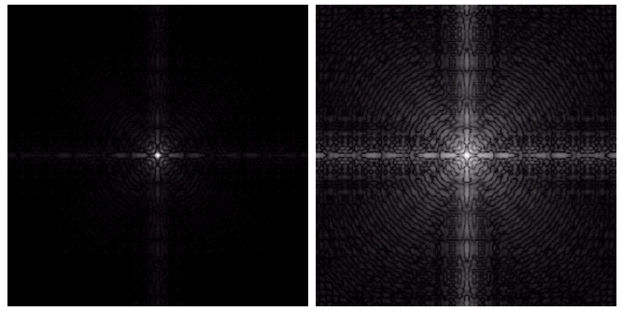
Logarithmic Transformations
Fourier spectrum: image values ranging from 0 to 1.5x10⁶
The result of log transformation with c = 1

Slide 23
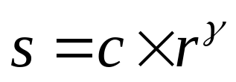
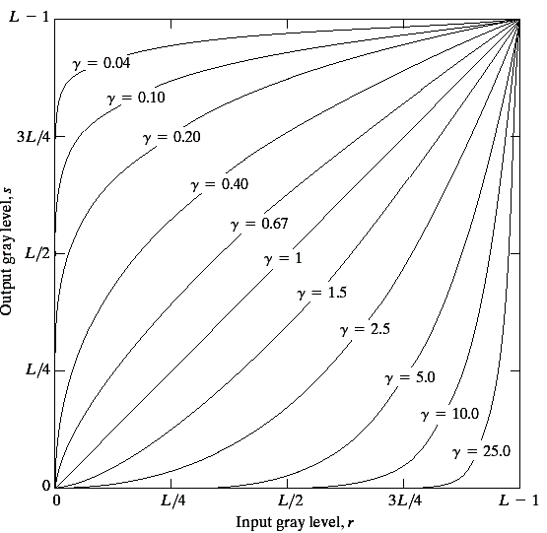
Power Law Transformations
Power law transformations have the following form
Map a narrow range
of dark input values
into a wider range of
output values or vice
versa
Varying γ gives a whole
family of curves

Slide 24
Power Law Transformations
For γ< 1: Expands values of dark pixels, compress values of brighter pixels
For γ > 1: Compresses values of dark pixels, expand values of brighter pixels
If γ=1 & c=1: Identity transformation (s = r)
A variety of devices (image capture, printing, display) respond according to a power law and need to be corrected
Gamma (γ) correction
The process used to correct the power-law response phenomena

Slide 25
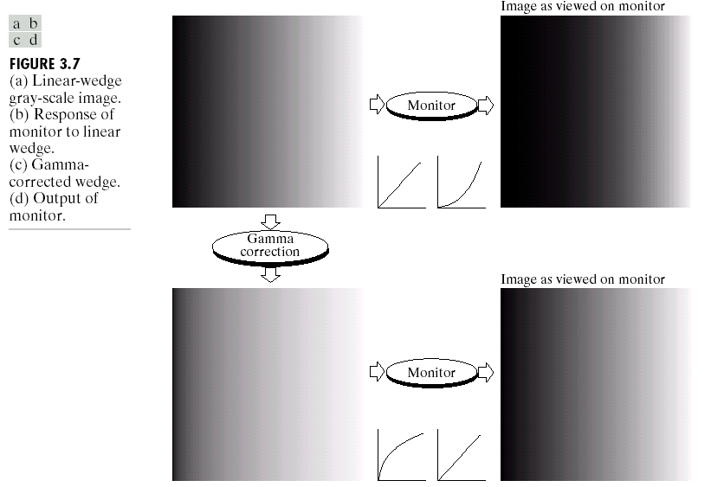
Power Law Transformations: Gamma Correction

Slide 26
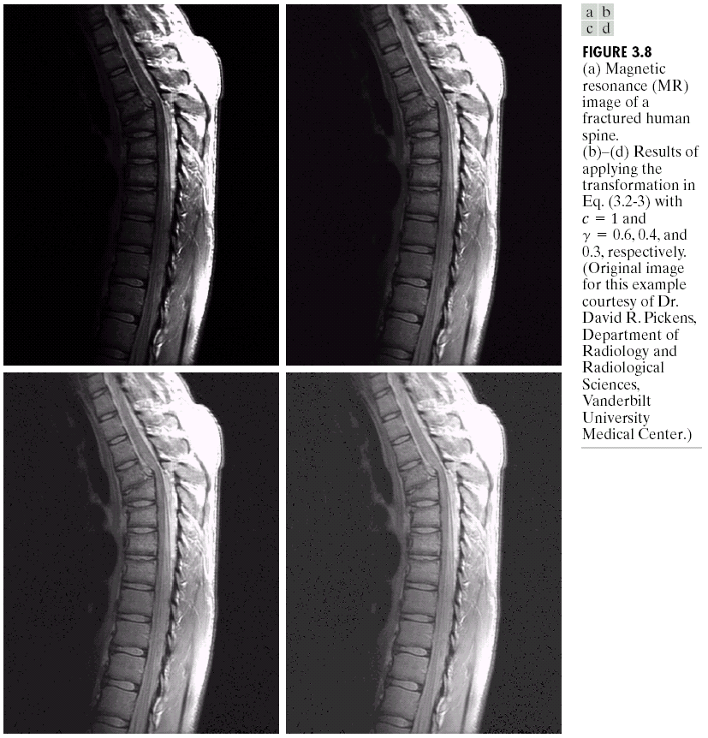
Power Law Transformations
Contrast Enhancement
The images to the right show a magnetic resonance (MR) image of a fractured human spine

Slide 27
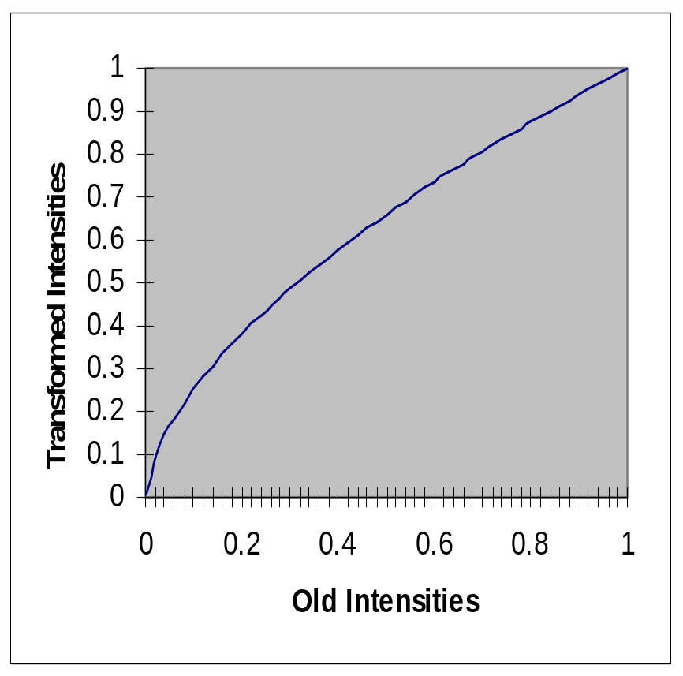
Power Law Transformations
Contrast Enhancement
γ = 0.6

Slide 28
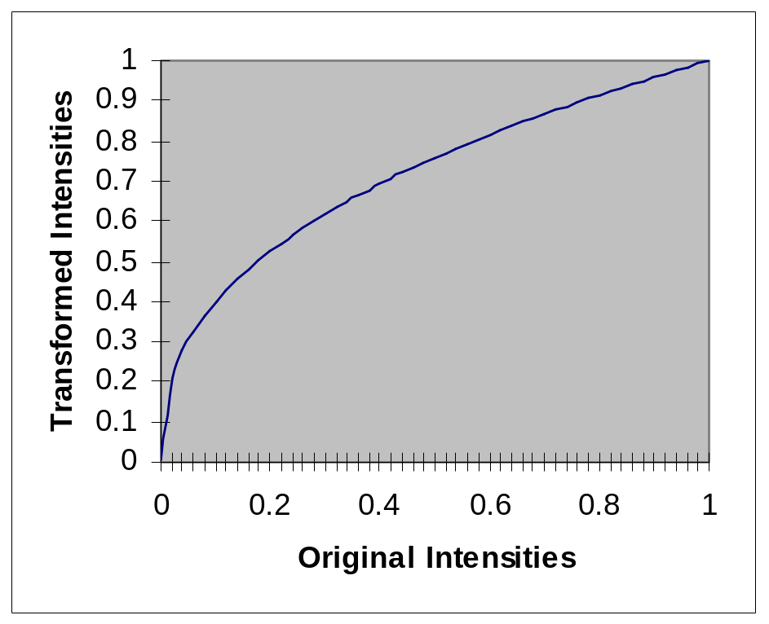
Power Law Transformations
Contrast Enhancement
γ = 0.4

Slide 29
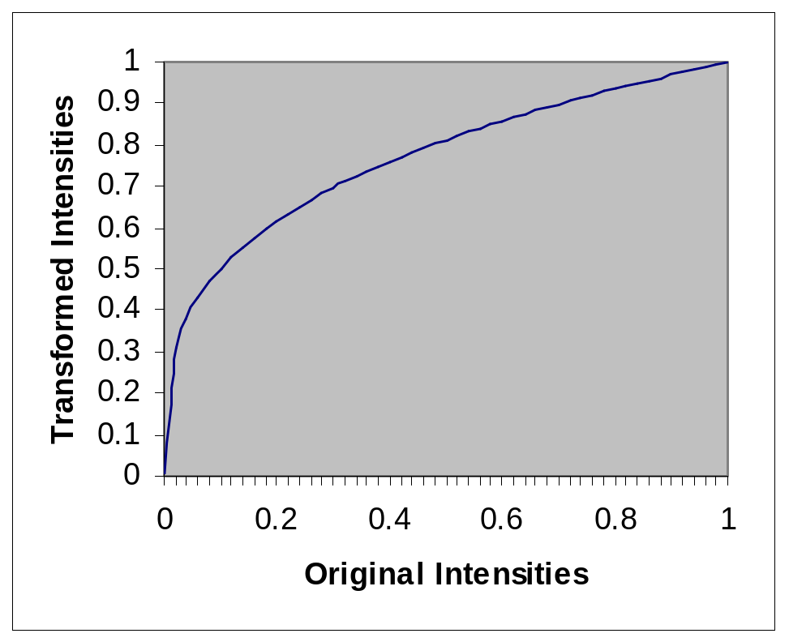
Power Law Transformations
Contrast Enhancement
γ = 0.3

Slide 30
Power Law Transformations
Contrast Enhancement
MR image of
fractured human spine
Result after
Power law transformation
c = 1, γ = 0.6
Result after
Power law transformation
c = 1, γ = 0.4
Result after
Power law transformation
c = 1, γ = 0.3

Slide 31
Power Law Transformations
Contrast Enhancement
When the γ is reduced too
much, the image begins to
reduce contrast to the
point where the image
started to have very slight
“wash-out” look.

Slide 32
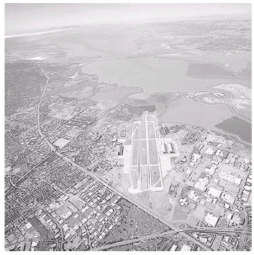
Power Law Transformations
Contrast Enhancement
Image has a washed-out
appearance – needs γ > 1

Slide 33
Image Enhancement
Aerial
Image
Result of
Power law transformation
c = 1, γ = 3.0
(suitable)
Result of
Power law transformation
c = 1, γ = 5.0
(high contrast, some regions are too dark)
Result of Power law transformation
c = 1, γ = 4.0
(suitable)

Slide 34
Piecewise Linear Transformation Functions
Contrast stretching
Intensity level slicing
Bit-Plane slicing

Slide 35
Contrast Stretching
Objective
  Increase the dynamic range of the gray levels for low contrast images
Rather than using a well defined mathematical function we can use arbitrary user-defined transforms
If r₁ = s₁ & r₂ = s₂, no change in gray levels
If r₁ = r₂, s₁ = 0 & s₂ = L-1, then it is a threshold function. The resulting image is binary

Slide 36
Contrast Stretching
r₁ = r_{min} & s₁ = 0
r₂ = r_{max} & s₂ = L-1

Slide 37
Contrast Stretching

Slide 38
Grey Level Slicing
Highlights a specific range of gray levels in an image
  Similar to thresholding
  Other levels can be suppressed or maintained
  Useful for highlighting features in an image

Slide 39
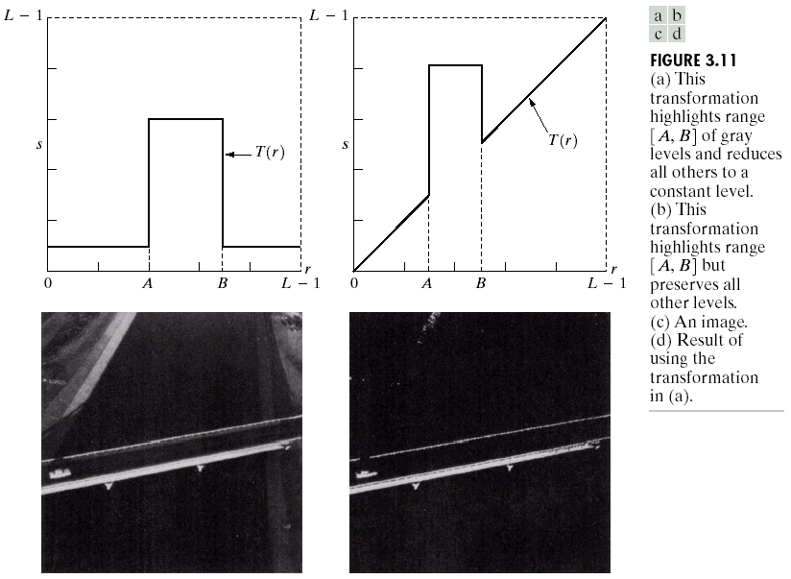
Grey Level Slicing
Highlights range [A,B] of gray levels and reduces all others to a contrast level
Highlights range [A,B] but preserves all other gray levels

Slide 40
Grey Level Slicing

Slide 41
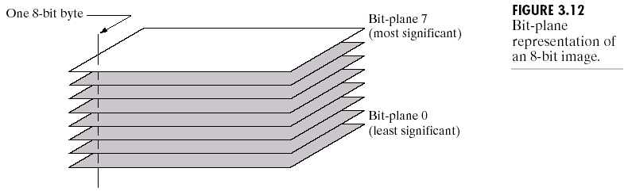
Bit Plane Slicing
Objective: Highlights the contribution made to the image appearance by specific bits
Suppose an image is of 8 bits i.e. each pixel is represented by 8 bits
Higher-order bits contain the majority of the visually significant data
Useful for analyzing the relative importance played by each bit of the image. It is useful in compression

Slide 42

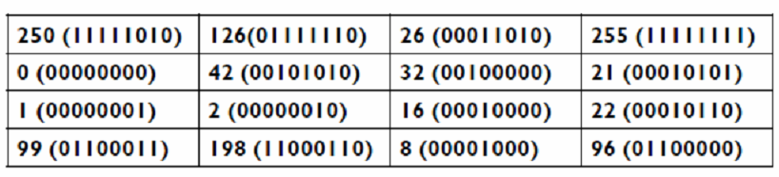
Bit Plane Slicing

Slide 43
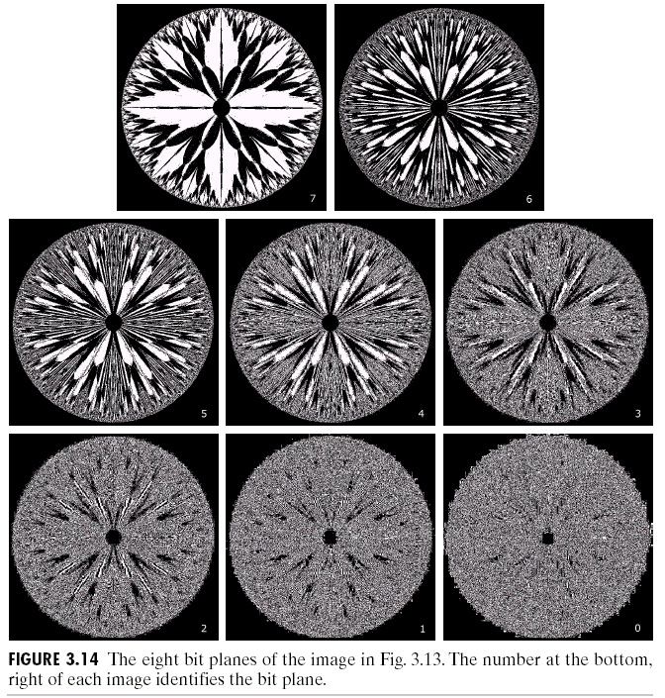
Image Enhancement
[10000000]
[01000000]
[00100000]
[00001000]
[00000100]
[00000001]

Slide 44
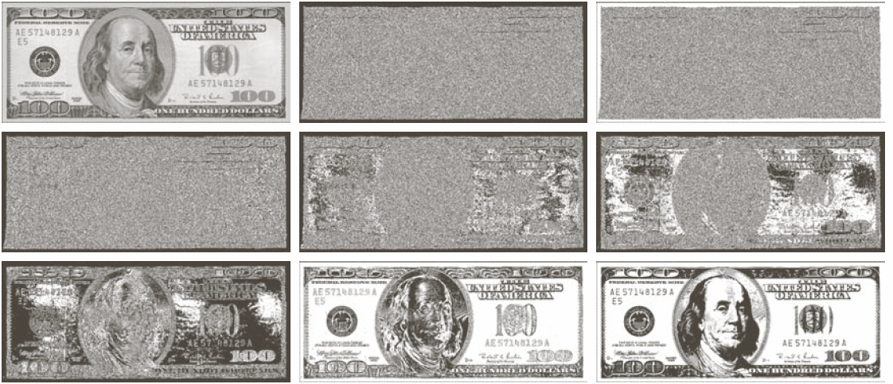
Bit Plane Slicing
Bit planes 1 through 8

Slide 45
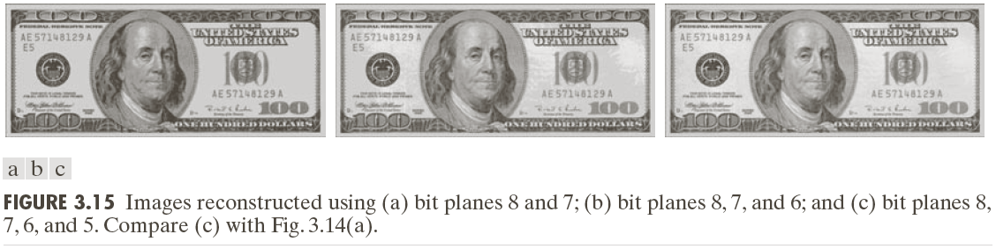
Bit Plane Slicing
Reconstructed image using only bit planes 8 and 7
Reconstructed image using only bit planes 8, 7 and 6
Reconstructed image using only bit planes 7, 6 and 5

Slide 46
Acknowledgements
Digital Image Processing”, Rafael C. Gonzalez & Richard E. Woods, Addison-Wesley, 2002
Peters, Richard Alan, II, Lectures on Image Processing, Vanderbilt University, Nashville, TN, April 2008
Brian Mac Namee, Digitial Image Processing, School of Computing, Dublin Institute of Technology
Computer Vision for Computer Graphics, Mark Borg
Material in these slides has been taken from, the following resources

